Slide 1
Yield Tool Tutorial
Bijan Nemati
2/13/2016

Slide 2
What does it primarily do?
The main calculations:
Signal and noise
Time to reach a given signal to noise ration (SNR)
Margin and time for imaging and characterization of known RV planets
Implementation:
Most recent version is in Excel
Matlab version also exists and needs updating
Can allow 2D dark holes in addition to the azimuthally averaged summaries used by the excel version

Slide 3
What this tutorial aims to cover
Basic use cases of the tool
How to trace calculations
Some tricks in excel
Named cells
Lookup (vlookup, hlookup)
Scenarios
Data tables
Conditional formatting

Slide 4
Analytical Expression for SNR
Photometric SNR means we include planet shot noise
Keep in mind that we are considering the post speckle-subtraction SNR
We write the total noise as:
The uncorrelated, random noise is given by:
Note: This is the post-subtraction error, and should in principle reflect noise contributions for both the target and reference images. However, consistent with our assumption that the reference is significantly brighter than the target, we consider the error being dominated by the target star image only.
$$SNR≡S=\frac{P}{σ_{tot}}$$
$$P=r_{pl} t$$
planet signal
$$σ_{tot}^{2}=σ_{r}^{2}+σ_{s}^{2}$$
random,
uncorrelated, reduces with t
Speckle subtraction error, excluding measurement noise
planet
speckle
zodi
dark
clk. Ind. Chg.
read noise
$$\frac{σ_{r}^{2}}{t}=r_{n}={f_{SR} F}^{2}\left[{Φ_{∗} C_{pl} τ_{pl}+Φ}_{∗}C_{CG}I_{pk}m_{pix}τ_{sp}+\left(\frac{dΦ_{Z}}{dΩ} ΔΩ_{PSF}\right)τ_{Z}\right] A_{PM} η+F^{2}\left[i_{d}m_{pix}+q_{CIC}\frac{m_{pix}}{t_{fr}}\right]+\frac{m_{pix}}{t_{fr}}{\left(\frac{σ_{rd}}{G_{EM}}\right)}^{2}$$
photonic (shot noise) terms
electronic terms
$f_{SR}≡$ fraction of core light in region of interest for SNR
$F≡$ EMCCD excess noise factor $∼\sqrt{2}$
$Φ_{∗}=F_{λ}⋅Δλ$ $Φ_{Z}=F_{λ}^{Z}⋅Δλ$

Slide 5
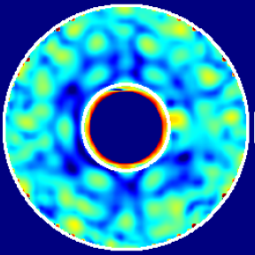
Looking a little more closely at $σ_{s}$
The speckle subtraction term $σ_{s}$ contains only the speckle instability effects.
Excludes noise in the subtracted images, and corresponds to the post processing error
For a given level of speckle instability, different post processing schemes (e.g. PCA, KLIP) will have different dependencies on prior data.
But, in the context of a single observation, taking a total integration time t, this error grows at the same rate as the signal, i.e., $σ_{s}=k t$
A useful version of this parameterization defines a post-processing improvement factor, which can depend on many variables unstated here, that is calculated from the residual speckle scene according to:
NB: The above definition shows how $f_{pp}$ is measured, not its dependencies!
From this definition, we have: $σ_{s}={f_{pp} r}_{sp} t$
$$f_{pp}≡\frac{σ_{s}}{r_{sp} t}$$
residual speckle, excluding shot noise;
$λ/D$ spaced grid superimposed on top
$r_{sp}≡$ mean raw speckle rate
$σ_{s}$ is given by the rms of the residual intensity variations after averaging within each $λ/D$ sized pixel

Slide 6

Putting it all together: time to reach SNR
planet rate
Analytical expression for SNR:
Speckle Subtraction Error:
Time to reach desired SNR:
$$S=\frac{r_{pl} t}{\sqrt{r_{n}t+σ_{s}^{2}}}$$
noise rate
$$σ_{s}=f_{pp} r_{sp} t$$
mean speckle rate
$t=\frac{S^{2} r_{n}}{r_{pl}^{2}−S^{2}{ f}_{pp}^{2} r_{sp}^{2}}$
OWA
Dark Hole
IWA ~ 3 λ/D
ROI

Slide 7
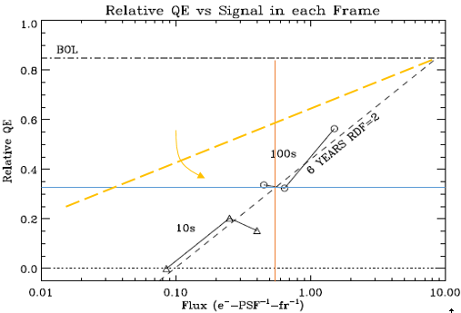
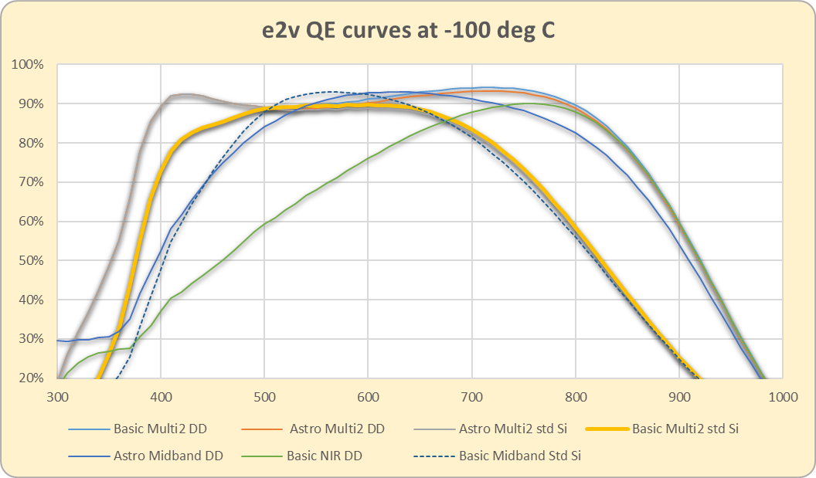
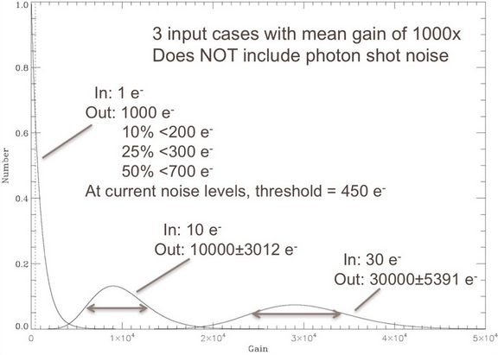


Conversion Efficiency
Fraction of photons counted to photons incident on the sensor
QE
CTE
$$ε_{PC}$$
Incident photon
Electron at pixel
Electron at amp
Counted electron
QE
CTE
$$ε_{PC}$$
conversion
efficiency
use to estimate shot noise
use to compute signal

Slide 8
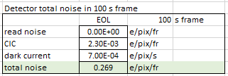
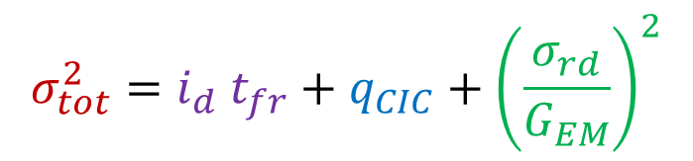
Requirement on Total Noise
What are the noise variance contributors for the detector at the end of mission, in a single frame, and a single pixel?
Read noise variance
Dark noise variance
Example: EMCCD
$$σ_{tot}^{2}=i_{d} t_{fr}+q_{CIC}+{\left(\frac{σ_{rd}}{G_{EM}}\right)}^{2}$$
CIC noise variance

Slide 9
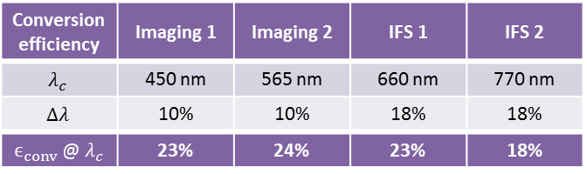
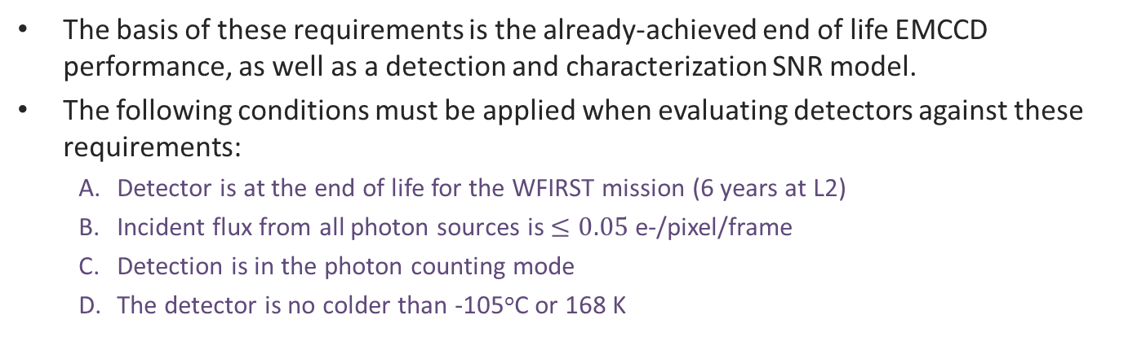
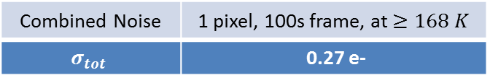
WFIRST Coronagraph Detector Requirements
The basis of these requirements is the already-achieved end of life EMCCD performance, as well as a detection and characterization SNR model.
The following conditions must be applied when evaluating detectors against these requirements:
Detector is at the end of life for the WFIRST mission (6 years at L2)
Incident flux from all photon sources is $≤0.05$e-/pixel/frame
Detection is in the photon counting mode
The detector is no colder than -105ºC or 168 K
Conversion Efficiency Defined as the fraction of times a single incident photon is counted as a single photon and includes
Quantum Efficiency
Charge transfer efficiency (where applicable)
Photon counting efficiency (thresholding efficiency)
Total Noise from one pixel in a 100s frame Defined as the standard deviation of the combined detector noise contributions from:
Read noise
Dark current
Clock induced charge (CIC, where applicable)
Conversion efficiency | Imaging 1 | Imaging 2 | IFS 1 | IFS 2
$$λ_{c}$$ | 450 nm | 565 nm | 660 nm | 770 nm
$$Δλ$$ | 10% | 10% | 18% | 18%
$ϵ_{conv}$ @ $λ_{c}$ | 23% | 24% | 23% | 18%
Combined Noise | 1 pixel, 100s frame, at $≥168 K$
$$σ_{tot}$$ | 0.27 e-

Slide 10
Calculating Planet Yield

Slide 11
A Simple Observing Scenario for Yield
We seek a simple analytical model of planet yield, via calculating the time to reach a desired SNR
We need to be explicit about the observing assumptions
We choose these assumptions:
We are after a photometric measurement
Though note that in detection, we would not be doing photometry. The SNR is different in that case.
We are doing differential imaging.
The SNR is the post-differential imaging SNR.
For simplicity we assume we are doing Reference Differential Imaging (RDI).
The reference star is brighter than the target star
If $ΔM>3$ between target and reference then $B_{T}>16{ B}_{R}$
Shot noise of reference speckles is small compared with shot noise of target speckles
There is a normalization step also
Exo-zodi is smooth and extended for both stars
Brightness distribution structures are >> lam/D
Target
$$P$$
$$B_{tar}$$
Reference
$$B_{ref}$$
Tar – Ref
(RDI)
$$P$$
$$Sig=I_{tar}−I_{ref}$$
$$=\left(P+B_{tar}\right)−B_{ref}$$
$$=P+\left(B_{tar}−B_{ref}\right)$$

Slide 12
Aside: Distinguishing types of SNR
Detection and spectroscopy are different statistical questions.
For spectrometry, with the IFS, we are interested in the photometric SNR:
For planet detection, with the imager, we would be interested in detection SNR:
The noise of interest in this case does not include the signal’s shot noise
We are instead interested in the background’s false positive probability
planet signal
$$S_{phot}=\frac{P}{\sqrt{P+B}}$$
background
$$S_{detec}=\frac{P}{\sqrt{B}}$$

Slide 13
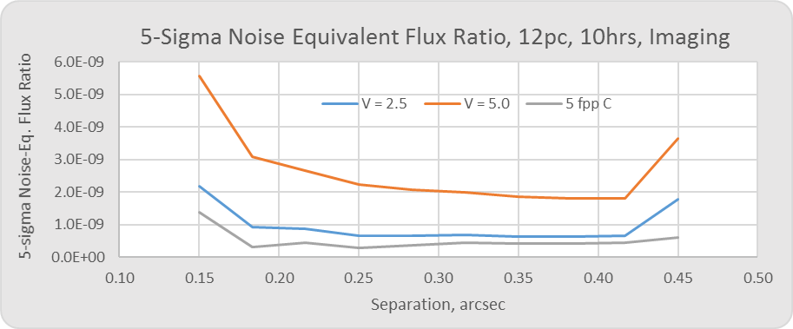
Noise Equivalent Contrast (NEC): $ξ_{eq}$
What is the minimum planet contrast that can be seen with SNR $≥$ 5 under our observing scenario?
Equivalent Contrast Definition:
The planet that will be detected with SNR of 𝑺 after integrating for time t is one which has a planet-contrast equal to the S-𝝈 equivalent contrast, after post processing:
signal
fraction
R
How dim a planet can be seen with SNR = S ?
Planet signal in the core region after t seconds
area
QE
$${f_{SR}⋅Φ}_{∗}ξ_{eq}{A τ}_{pl} η t=S{⋅σ}_{tot}$$
flux
thruput
time
T
$$ξ_{eq}=κ{⋅σ}_{tot}$$
$$κ≡\frac{S}{{f_{SR}Φ}_{∗}{A τ}_{pl} η t}$$
This conversion factor is set by the scenario parameters
$$ξ_{eq}^{V=5}$$
$$ξ_{eq}^{V=2.5}$$

Slide 14
Asymptotic Behavior of $ξ_{eq}$
How does the NEC depend on post processing and integration time?
For imaging, $f_{SR}=1$, so for simplicity we drop this factor, and we have:
For very short times the first term dominates and there is no benefit from post-processing
At large times, the first term under the radical drops out, so that we arrive at:
Our definitions of NEC:
$$Φ_{∗}ξ_{eq}{A τ}_{pl} η t=S\sqrt{r_{n}t+f_{pp}^{2}r_{sp}^{2}t^{2}}$$
$$σ_{tot}$$
$$ξ_{eq}=S\sqrt{\frac{r_{n}}{Φ_{∗}^{2}{A^{2}τ}_{pl}^{2}η^{2} t}+f_{pp}^{2}\frac{C_{CG}^{2}I_{pk}^{2}m_{pix}^{2}}{τ_{core}^{2}}}$$
$σ_{t}$ dominated; not much benefit
from post-processing
$$ξ_{eq}$$
t
$$ξ_{eq} \underset{→}{\text{t}→∞} S f_{pp}\left(t\right)\frac{C_{CG}I_{pk}m_{pix}}{τ_{core}}$$

